Slide 1
Adult education outreach
Daniel Reynaga
March 19,2023
reynagd@protonmail.com

Slide 2
Agenda
What is happening?
Defining the Problem
What are short/long term Goals
What is the Approach?
Questions / Comments /Feedback

Slide 3
What is Happenning?
Psychological Conditioning and Conditional Access Infrastructure is underway… 2030
Public Education and Parental Rights
  Children –exposed to alternate life styles or identities
Energy Control
Food Production Control -sustainable
Climate Change Agenda - Carbon Foot Print
Digital ID Implementation - Zero Trust Concept
Centralized Digital Currency
Smart Cities -15 Minute Cities - Geofencing (digital prison)
Access to Internet and Media ( content moderation & sensorship)
Gun Control – Infringement on the 2nd Amendment
Erosion of Checks and Balances
  ( Centralization of Government Power )

Slide 4
What is happening?
  Artificial Intelligence – used against those who dissent
  No Cures for Diseases – only symptoms
    Any doctor who tries to be a real Doctor and actually cures people is discredited out of the profession
  Environmental Manipulation -Pesticides and other chemical agents
  GMOs -Insects, plants, animals, meat .. Food supply
  Transhumanism- — the merging of humans with sophisticated technologies that greatly enhance human intellectual, physical, and psychological capacities.
  Transgenderism

Slide 5
What is happening?
Case Example – Think tank reports are being generated for justification of measures taken.
BROOKINGS Institute (Feb 2023)
https://www.brookings.edu/essay/audible-reckoning-how-top-political-podcasters-spread-unsubstantiated-and-false-claims/
They are producing papers that state “unsubstantiated claims” are five times greater from conservative podcasters.
These types of reports may be used to justify governmental orders/commands to news and social media organizations resulting in censorship/violations of constitutional rights for the greater good?

Slide 6
Podcast
Unlike turning on the radio, listening to a podcast is also more of a deliberate and decentralized act.²² The downloadable nature of a podcast episode means that listeners can begin and pause that episode whenever they want. A radio show, by contrast, happens at a specific time and on a specific station and may not repeat. This distinction is because podcast series are hosted across a wide range of websites – like Anchor, Libsyn, or BuzzSprout – and they can easily be downloaded to and saved on a slew of applications (including Spotify, Audible, or Apple Podcasts) for listening at a later date. As a result, podcasting offers a far more decentralized – and diverse – distribution mechanism than radio. This makes it far more difficult to implement uniform content moderation guidelines for podcasting.
https://www.brookings.edu/essay/audible-reckoning-how-top-political-podcasters-spread-unsubstantiated-and-false-claims/

Slide 7
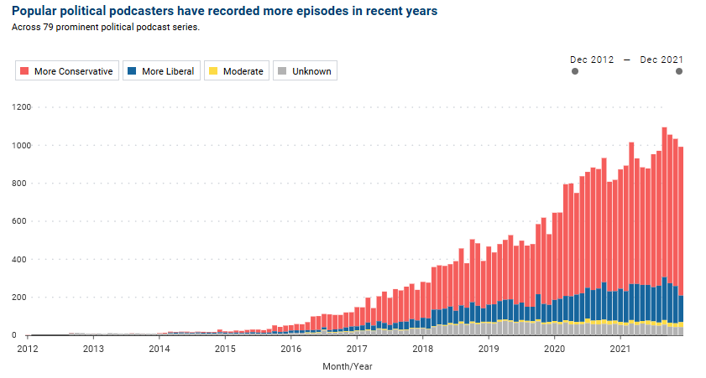
What is happening?
https://www.brookings.edu/essay/audible-reckoning-how-top-political-podcasters-spread-unsubstantiated-and-false-claims/

Slide 8
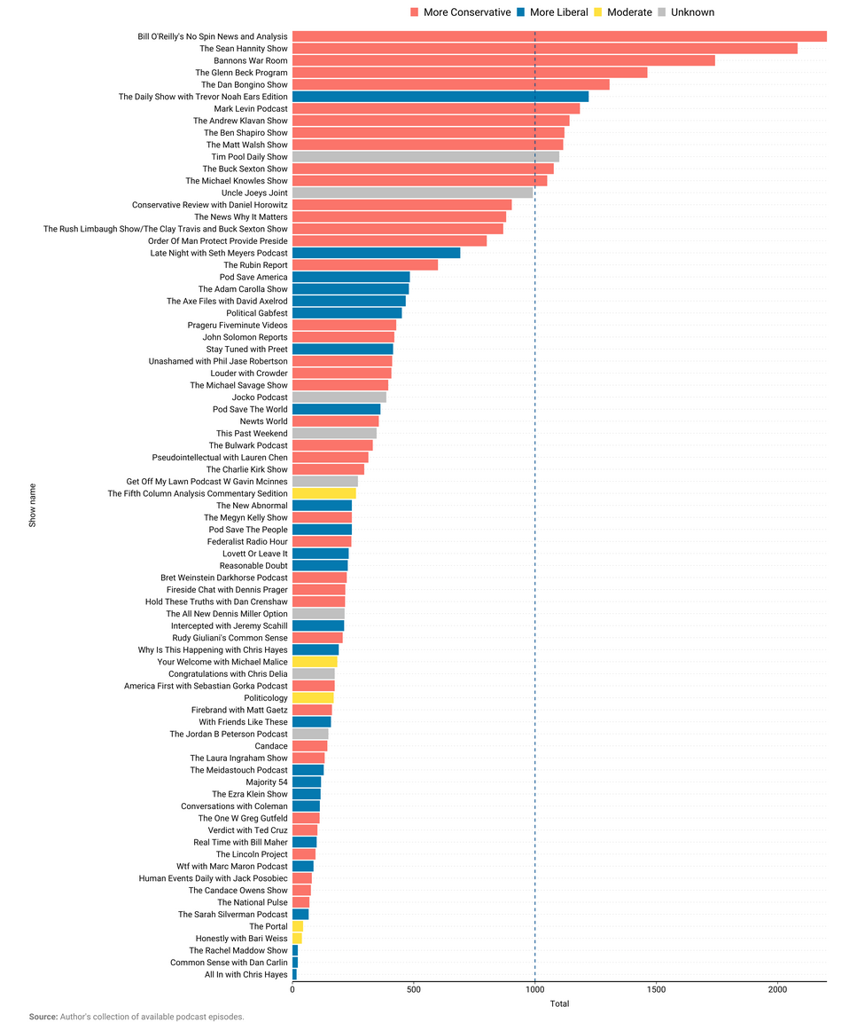
What is happening?
Prevalence Is Not Representative of Institutional Government Policy

Slide 9
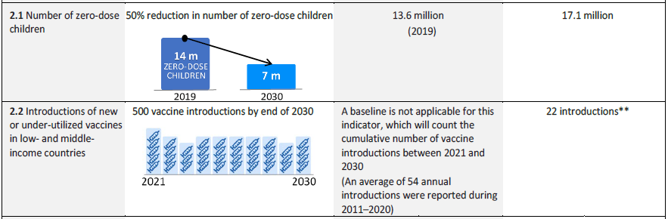
Defining the Problem(s)
https://health.gov/healthypeople/objectives-and-data/browse-objectives/vaccination
https://apps.who.int/gb/ebwha/pdf_files/WHA74/A74_9Add4-en.pdf

Slide 10
Defining the Problem
The Adult Masses don’t know where we are heading
Adults Are Instilled with Self Doubt and Fear
  The Promise of Security at the cost of Liberty
  The Promise of saving the Planet at the cost of everything
  Only Silent Obedient Consent is required
Through Fear, people there have all their lifetime been subject to bondage – Heb 2:15

Slide 11
What is the Approach?
    Web Content Amplification
      Enlist Influencers ?
      E-Mail and Flyers(QR codes)
      Expand Across Social Media Platforms ( Telegram)
      Podcasts
    Precinct Chair Concept (your neighbors)
      Know and Recruit your Neighbors
        E-mail lists, phone numbers,
          keep your neighbors informed
        Registered Voters
        Speaking at City Council meetings
        E-mail or call your legislators
        i.e. Rise Canada
    Actions must be decentralized

Slide 12
What is the Approach?
Study and practice this process, and you’ll influence, not manipulate, and change minds. Start with these six keys:
Understand the decision cycle.
1. People move through six predictable stages—a universal decision cycle—whenever they make a change. If you can’t identify where someone is in the decision cycle, you probably won’t understand how to exercise influence at each stage. For instance, in the “Satisfied” stage, many people will simply say they’re satisfied just to fend off early attempts at change. Your task, then, is merely to listen and learn; in this way, you’ll gain the perspective you’ll need in other stages.
https://www.searchenginejournal.com/influencer-program-technology/396052/#close

Slide 13
What is the Approach?
2. Establish trust.
If people don’t trust you, they won’t allow you to influence them. A smart, simple way to establish trust is to talk less and listen more. Try using the 4 A’s: Ask open questions, Actively listen, Aim well (to guide the conversation in the desired direction), and Avoid problems. By alleviating the stress that a conversation about change can cause, you’ll build trust.
https://www.searchenginejournal.com/influencer-program-technology/396052/#close

Slide 14
What is the Approach?
3. Create urgency.
Four out of five people readily admit that something in their life requires a change, but they just as readily admit that they aren’t doing anything about it yet. This is why influence requires urgency. To create urgency, ask probing questions that help people to consider the issue, contemplate the what-ifs, and comprehend the consequences. Use a sequence of simple probes that gently move the conversation closer to the real problem—questions such as, “What concerns do you have about the debt you’re building up?” and “How do you think this’ll ultimately affect your family’s future?” Your goal is to guide people to see the potential impact of indecision.
https://www.searchenginejournal.com/influencer-program-technology/396052/#close

Slide 15
What is the Approach?
4. Gain commitment.
Most people don’t just show up ready to commit to change—to, say, simply end a destructive addiction or leave a detrimental relationship or work environment. There needs to be a moment of truth, a moment of commitment. Ask the most important question never asked: “Are you committed to making a change?”
https://www.searchenginejournal.com/influencer-program-technology/396052/#close

Slide 16
What is the Approach?
5. Initiate change.
We’ve all heard the saying, “You only have one chance to make a first impression.” When it comes to initiating change, that one chance usually boils down to about 45 seconds. This makes your opener particularly important. The worst opener: “I need to talk with you.” (Think about how those six words make you feel. Not great, right?) The best openers include softer words and phrases, such as ask you, listen to you, or need your help.
https://www.searchenginejournal.com/influencer-program-technology/396052/#close

Slide 17
What is the Approach?
6. Overcome objections.
It’s human nature for people to resist change. They may fear change, think it’s not needed, or feel there’s no hurry. The good news? People are more likely to change their minds if they have at least one objection. To overcome objections, you must clarify, clarify, clarify. Only then can you get to the bottom of someone’s concerns and distinguish between real objections and procrastination.
Finally, the line between influence and manipulation often comes down to intent. So ask yourself if you believe. That is, do you truly believe that the idea or solution you seek to push someone toward is in that person’s best interest?
If your answer is yes, you have the very foundation of influencing—not manipulating.
Rob Jolles is a global speaker and trainer specializing in influence and persuasion and is a multi-best-selling author. His new book is How to Change Minds: The Art of Influence without Manipulation (Berrett-Koehler, 2013). For more information, visit jolles.com.
https://www.searchenginejournal.com/influencer-program-technology/396052/#close

Slide 18
What are short/long term Goals
Short Term Goals
  Determine your precinct
  Know your Neighbors
  Introduce yourself as the neighbor down the street
Long Term Goals
Establish Yourself as a trusted resource
Help Establish other Precincts.

Slide 19
Questions and Comments
What spirit can that be, which by a hidden inspiration stirs men’s corruption and goads them..
  .. deceive the few who are good..
  .. gain possession of the millions who are wicked..
–St. Augustine City of God

